Slide 1

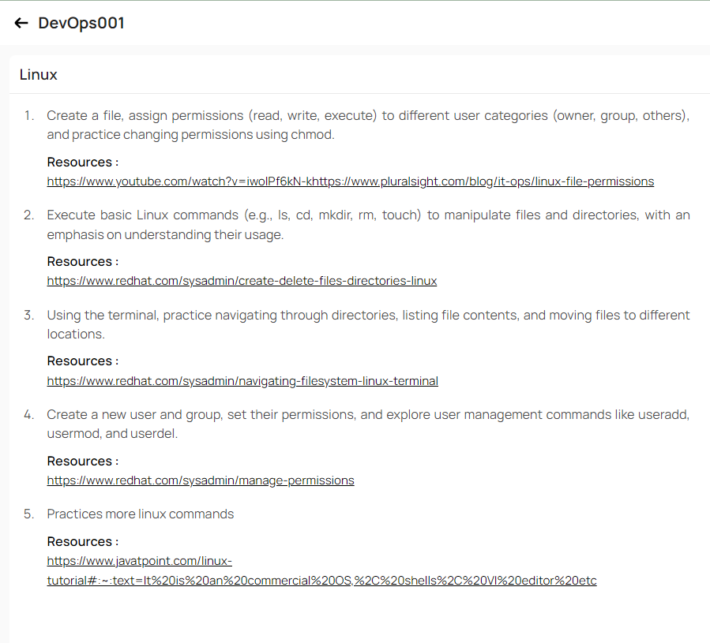
Himanshu Kumar Singh

Slide 2
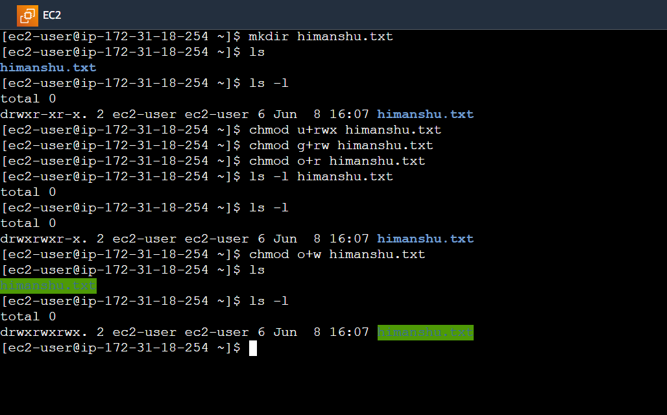
1. Creating a file and Assingning Permissions :-

Slide 3
1. Create a File :- mkdir himanshu.txt
2. Cheak the file Permissions using:- ls –l
3. Changing Permissions Using Chmod:-
chmod u+rwx himanshu.txt
chmod g+rw himanshu.txt
chmod o+r himanshu.txt
4. Again Check The Changes :- ls -l

Slide 4
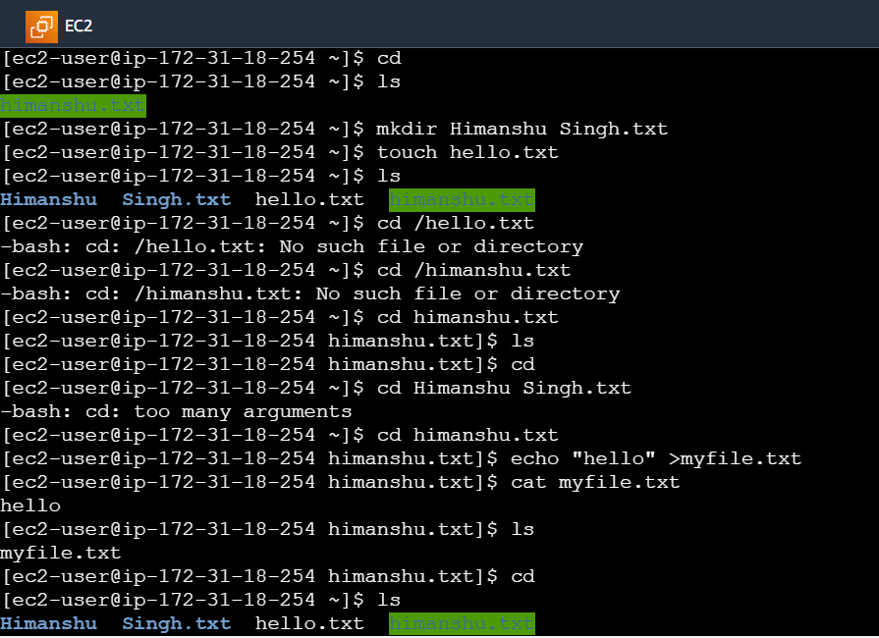
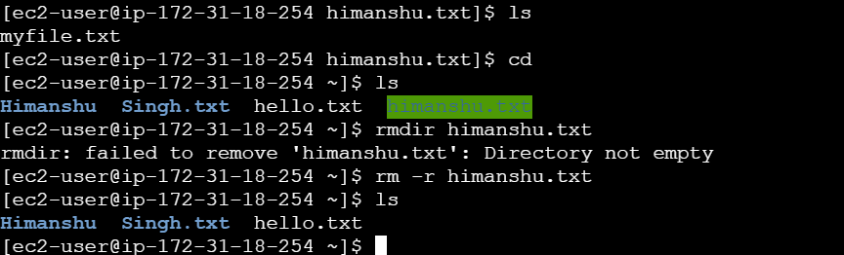
2. Executing Basic Linux Command :-

Slide 5
List directory contents using ls: ls
Change directory using cd: cd himanshu.txt
Create and write to the file using echo : echo "hello" >myfile.txt
Verify the content of the file: cat myfile.txt

Slide 6
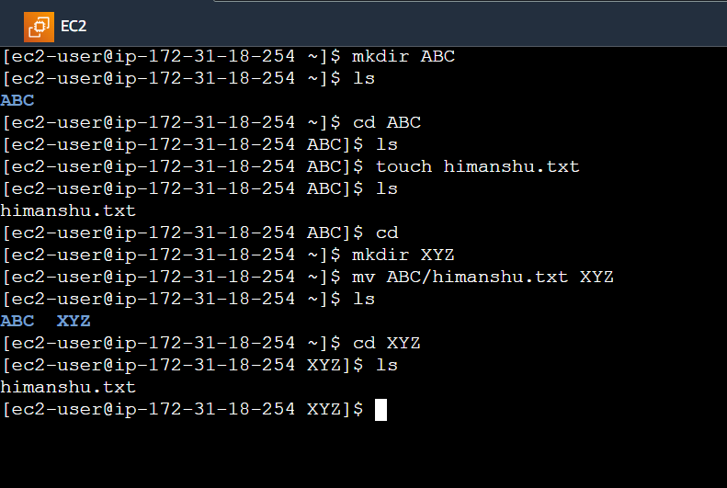
3. Navigate Through Directories :-

Slide 7
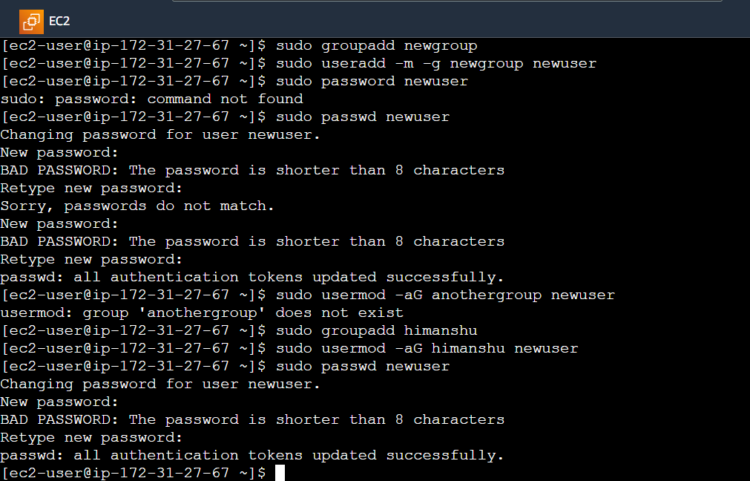
4. Create a New User And Group :-

Slide 8
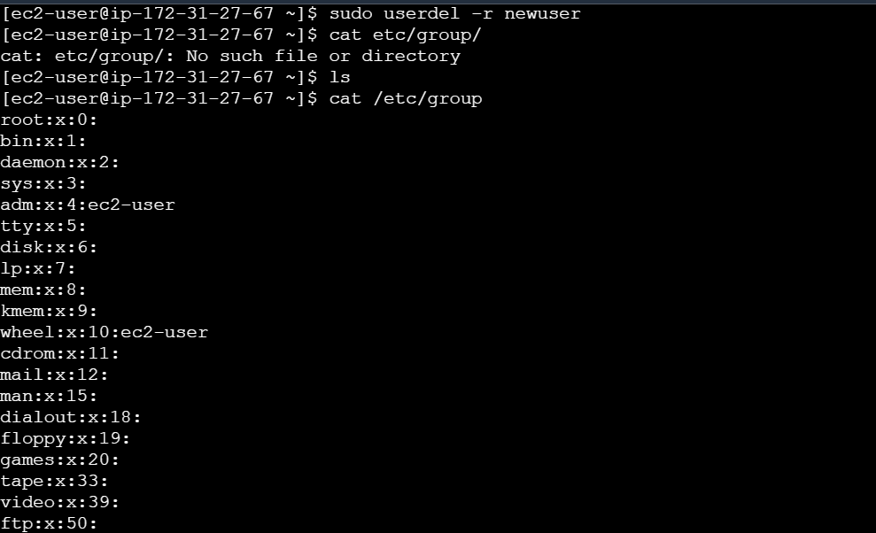

Slide 9
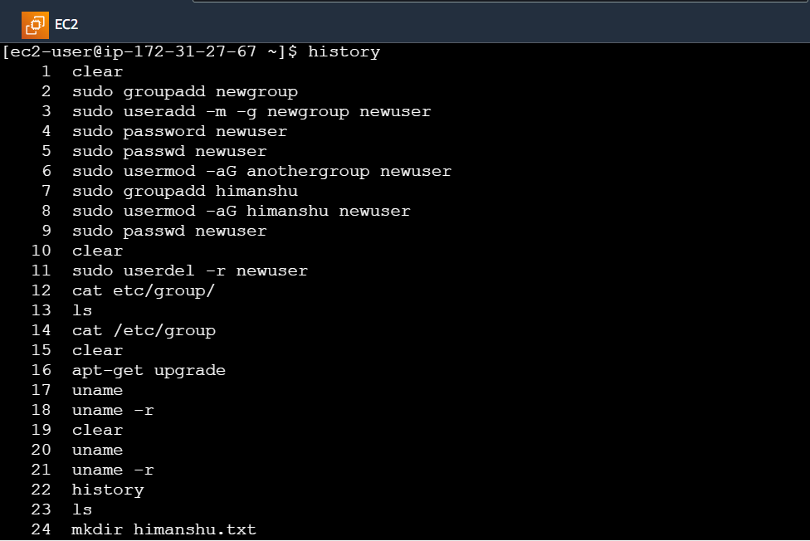
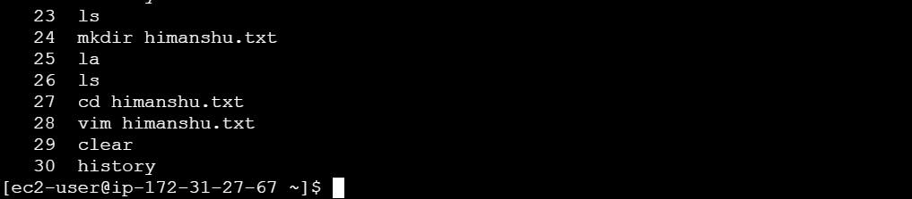
5. More Linux Commansd :-

Slide 10
Thanks

